Slide 1




Solving binary MQ with Grover’s algorithm
Sorbonne Université - Laboratoire LIP6
Arthur Stievenard & Julien Mayer

Slide 2
Definition of the problem
Problem. A system of quadratic equations over 𝐹₂ in convenient form is given by a ‘cube’ (𝜆^{k}_{ij})_{i,j,k} in 𝐹₂ where (𝜆^{k}_{ij})_{i,j,k} = 0 whenever i > j. The goal is to find 𝑥₁, . . . , _{n} ∈ 𝐹₂ such that :
∑_{1≤i≤j≤n} (𝜆¹_{ij})_{i,j,k} 𝑥_{i}𝑥_{j} = 1
…
∑_{1≤i≤j≤n} (𝜆^{m}_{ij})_{i,j,k} 𝑥_{i}𝑥_{j} = 1.
Example:
𝑥₁ * 𝑥₃ + 𝑥₂ = 1 𝑥₁ + 𝑥₂ * 𝑥₃ = 1
[0, 0, 1] [1, 0, 0]
[0, 1, 0] [0, 0, 1]
[1, 0, 0] [0, 1, 0]

Slide 3
Grover’s algorithm
Created by Lov Grover in 1996.
Also known as the quantum search algorithm.
Finds the inputs to a ‘black box’ (oracle) function that produces a particular output value.
Using Ɵ(⎷N) evaluations while classical algorithms use Ɵ(N) evaluations
Grover's algorithm can be viewed as solving an equation or satisfying a constraint.

Slide 4
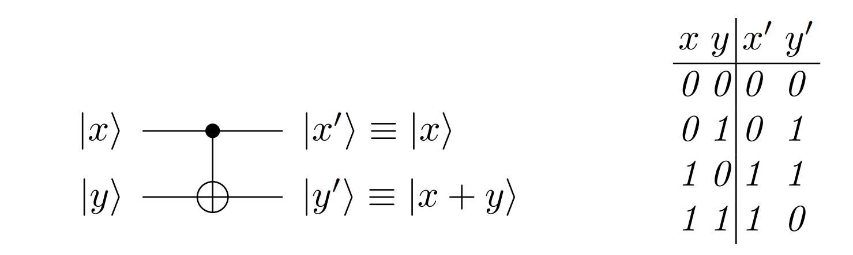

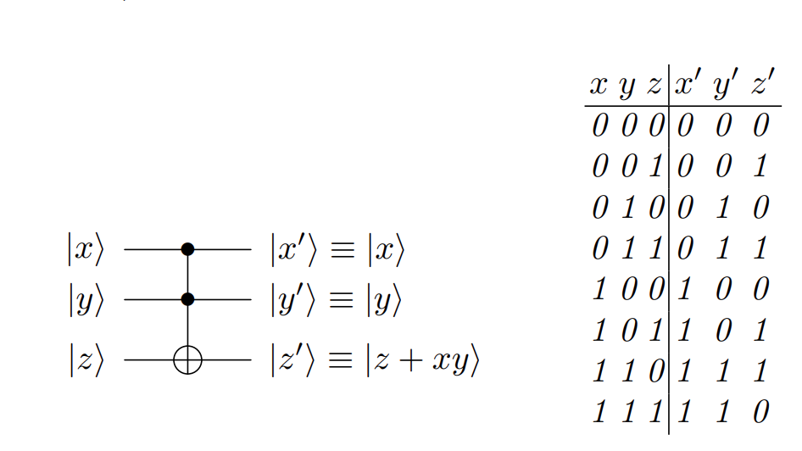
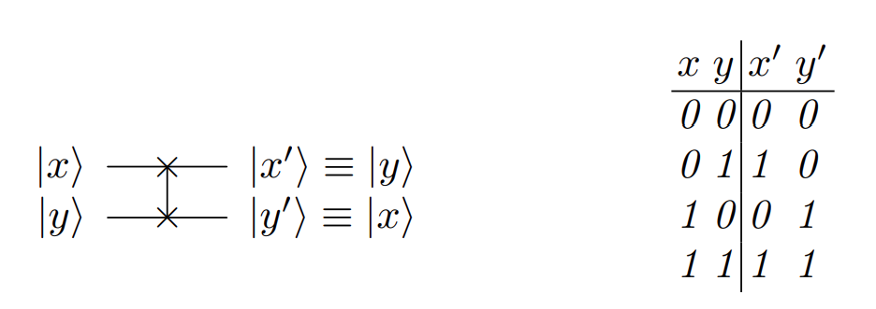
A collection of quantum gates
X gate - NOT
CNOT gate - OR
Toffoli gate - AND
SWAP gate

Slide 5
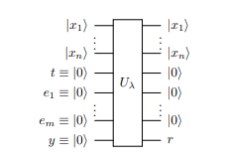
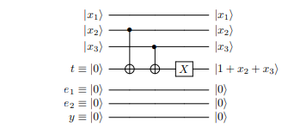
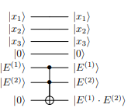
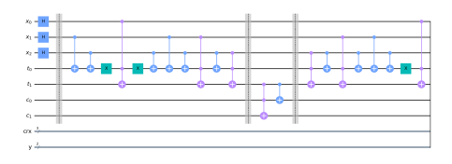
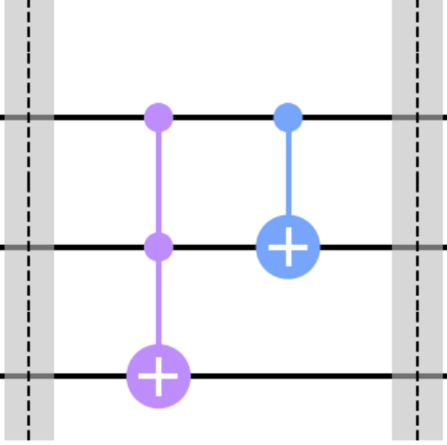

1st Oracle
2nd Oracle
00 - 01 - 10 - 11 - …

Slide 6
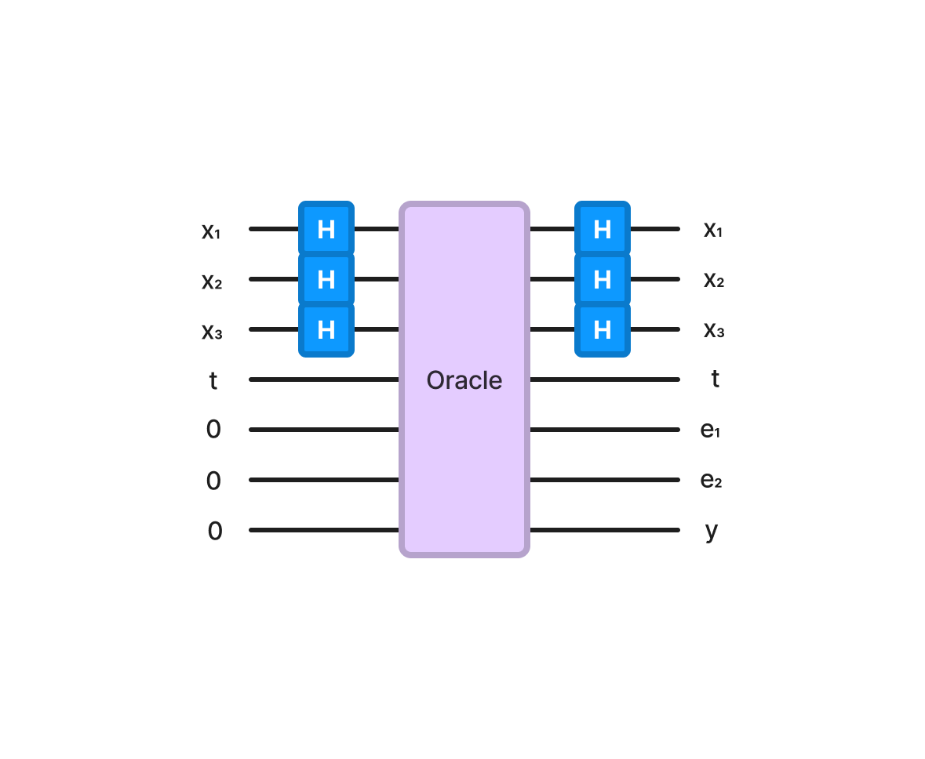
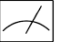
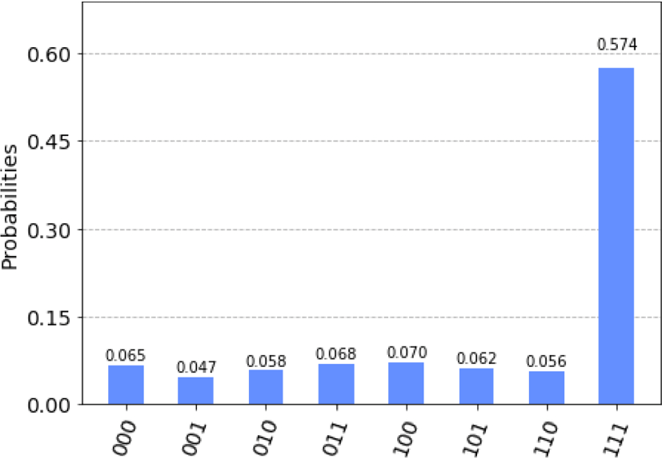
Results
Create a superposition of every states between 0 and 2^{n} with Hadamard gates.
Input all the possible states in the oracle function.
Measure the output registre ‘y’ to find the solutions.
The states observed the most in the results histogram of ‘y’ are the solutions for ‘x’ to the binary quadratic system.

Slide 7
Thank you for your attention !
Arthur Stievenard & Julien Mayer

